Slide 1
How to casual riders use bikes differently from member riders
By
Rahul Shankar Iyer

Slide 2
Data Sources
Index of bucket "divvy-tripdata“
The above link contains zip files with excel sheets covering the trip data between the years 2013-2021
Some of the sheets in this link contain trip data of an entire year, one quarter of an year, one half of a year, or one month of a year
For the purpose of this project, I chose to analyze the data from the following zip files:
202101-divvy-tripdata
202102-divvy-tripdata
202103-divvy-tripdata
202104-divvy-tripdata
202105-divvy-tripdata
202106-divvy-tripdata
202107-divvy-tripdata
202108-divvy-tripdata
202109-divvy-tripdata
202110-divvy-tripdata
202111-divvy-tripdata
202112-divvy-tripdata
Divvy_Trips_2019_Q2.zip
Divvy_Trips_2019_Q3.zip
Divvy_Trips_2019_Q4.zip
Divvy_Trips_2020_Q1.zip

Slide 3
Data Transformations
Added a column named ride_length to calculate the time taken for each bike journey.
Calculation of ride_length: ended_at – started_at, Format: ‘HH:MM:SS’
Added a column named day_of_week to mention which day of the week on which each trip happened
Calculation of day_of_week: WEEKDAY(started_at,1), Values range from 1-7
Generated Pivot tables to show the weekly stats of both the casual and member riders every month & quarter of the year 2021 – average ride lengths and number of rides
For 2019-2020 data,
We re designed the columns so that they will be the same, removing the latitude, longitude, birth year and gender fields
In the "member_casual" column, we replaced "Subscriber" with "member" and "Customer" with "casual“
The date field was split into day, month and year of the ride
ride_length column was added to the table and converted to a numeric value for further calculation. Rows with station name as “HQ QR” or ride_length < 0 were removed from the dataset

Slide 4
Analysis
While analysis on 2021 data was done in excel and Bigquery SQL, analysis of April 2019-March 2020 data was done in Bigquery SQL and Rstudio.
The below were the following comparisons done:
Number of Casual Riders vs Number of Member Riders on each day of the week
Average Ride Length of Casual Riders vs Average Ride Length of Member Riders on each day of the week

Slide 5
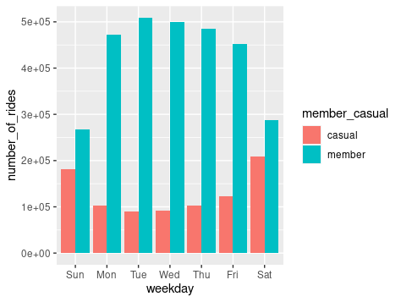
Number of Casual Riders vs Number of Member Riders on each day of the week
Notes:
The number of member riders is higher than the number of casual riders on any day of the week, but that difference narrows down on the weekends

Slide 6
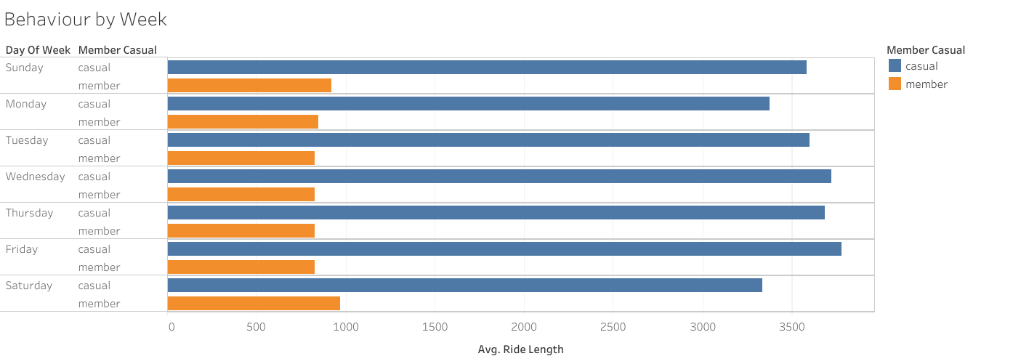
Average Ride Length of Casual Riders vs Average Ride Length of Member Riders on each day of the week
Notes:
The average ride length of the casual riders is significantly higher than that of the member riders

Slide 7
Monthly Frequency of Casual and Member Riders

Slide 8
Monthly Average Ride Length of Casual and Member

Slide 9
Key findings
Casual riders on an average, ride longer than member riders
The number of casual riders increased during the weekend while the number of member riders decreased during the weekend
The first two findings together indicate that members are generally commuters, while casual riders generally ride for leisure
Number of riders reached its peak during the summer, especially July and August, and tapered off during winter, which probably indicates that a lot of riders are school kids

Slide 10
Recommendations
Introduce 3 new types of membership:
Weekend membership (Saturdays & Sundays)
Summer membership (May-October)
Weekend-Summer hybrid membership (Saturdays & Sundays and all of July & August)
Given that a big % of the members are commuters, approach the Corporations and local businesses to enroll their employees and offer group discounts

